Slide 1
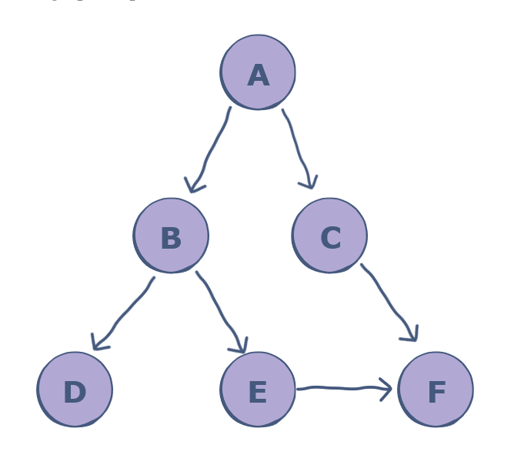
Finding Inefficiencies
Create a Deep For Search function for bus
Depth-first search (DFS), is an algorithm for tree traversal on graph or tree data structures. It can be implemented easily using recursion and data structures like dictionaries and arrays.

Slide 2
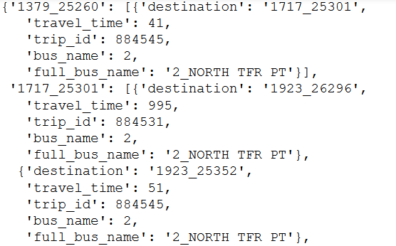
Created a graph of the current nodes next possible node
Times set between 7 – 9 am when people are going to work.
Made to avoid ‘drop off only’ buses

Slide 3
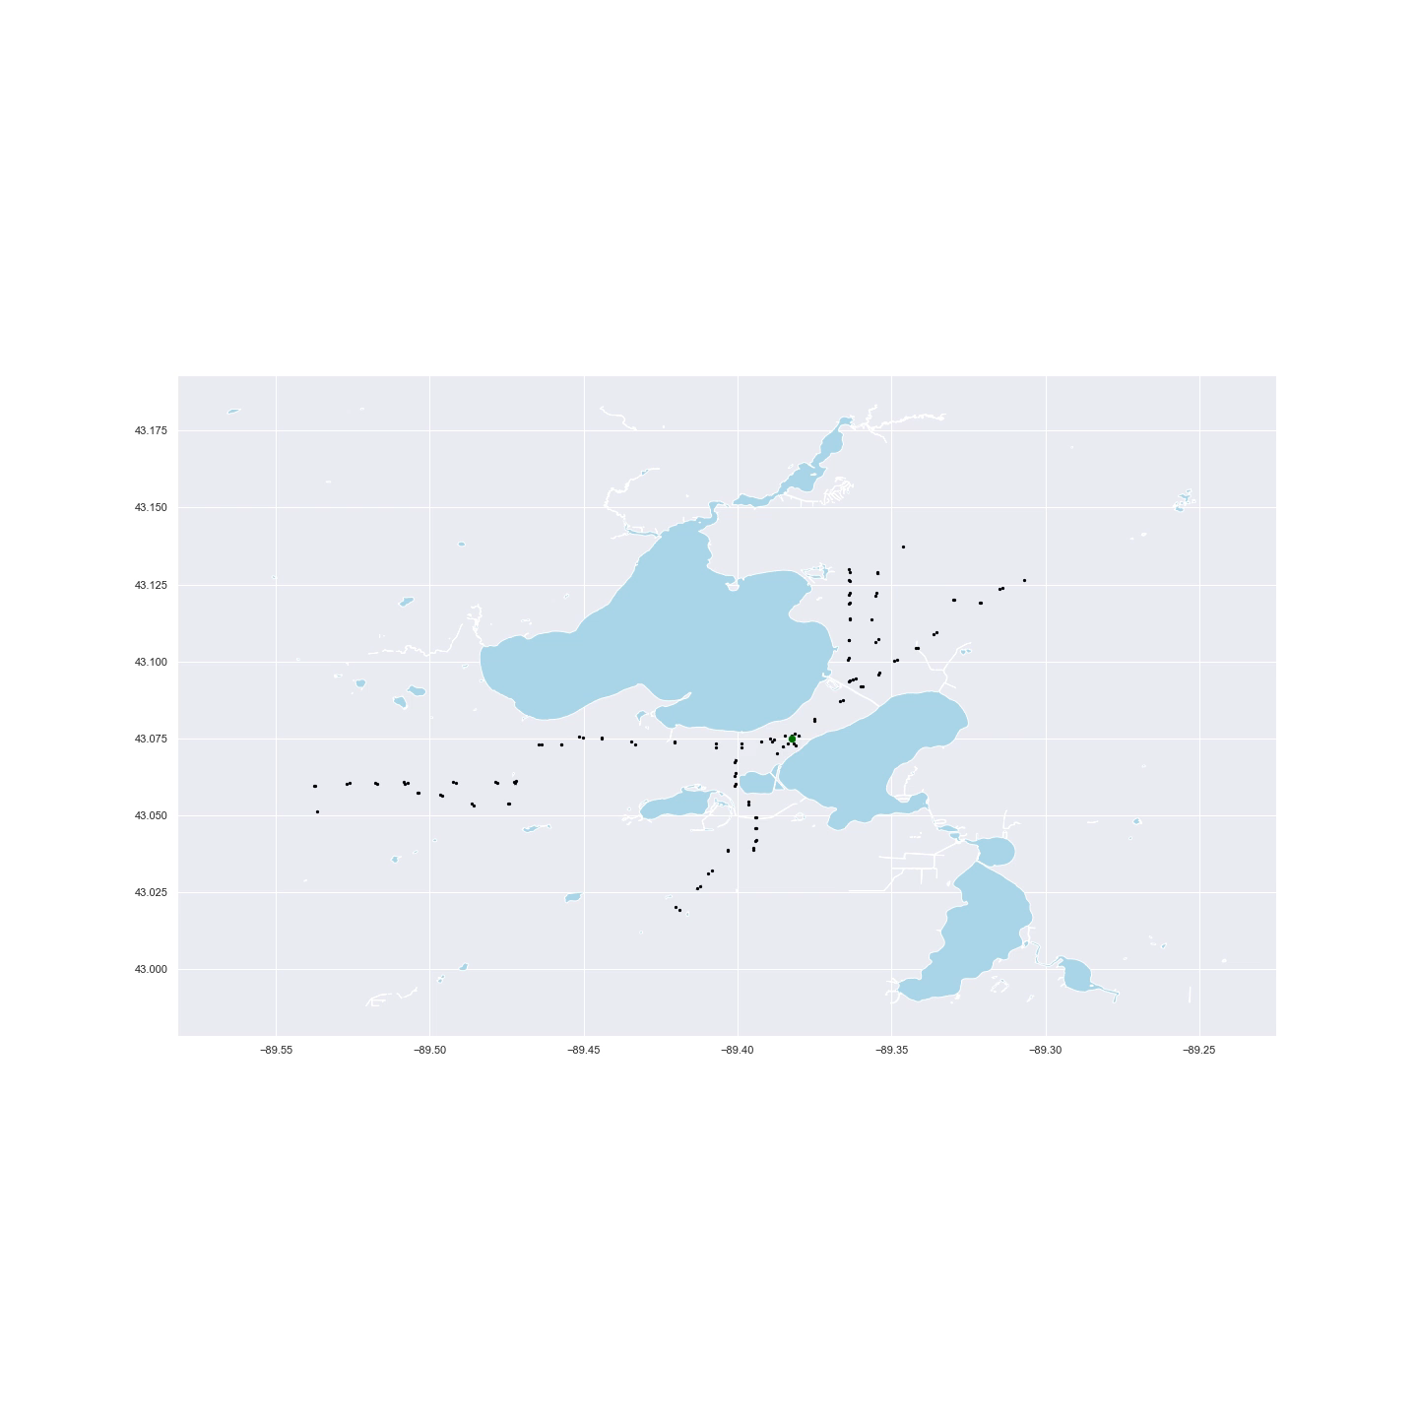
Travel time for an hour
Starting at stop 1787 covered the highest ratio of covered stops/all stops with 0.799
Most of the other starting stops with higher ratio near the campus

Slide 4

Reduced travel time to 30 minutes
In the US, Average commute time for people is 26.6 min.
Stop 741 had the highest stop coverage ratio with 0.226

Slide 5

Unlike the one-hour travel time, 30 minute travel time had starting stops out side of campus which had a high coverage ratio as well.
Stop 7100 had coverage of 0.224

Slide 6
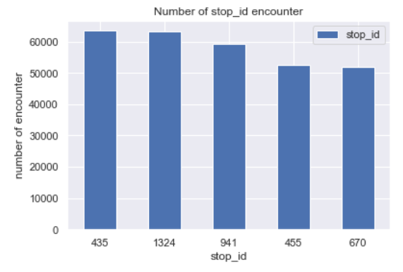
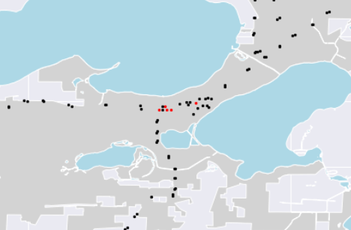
The top encountered stop ID for the 30 minute travel

Slide 7
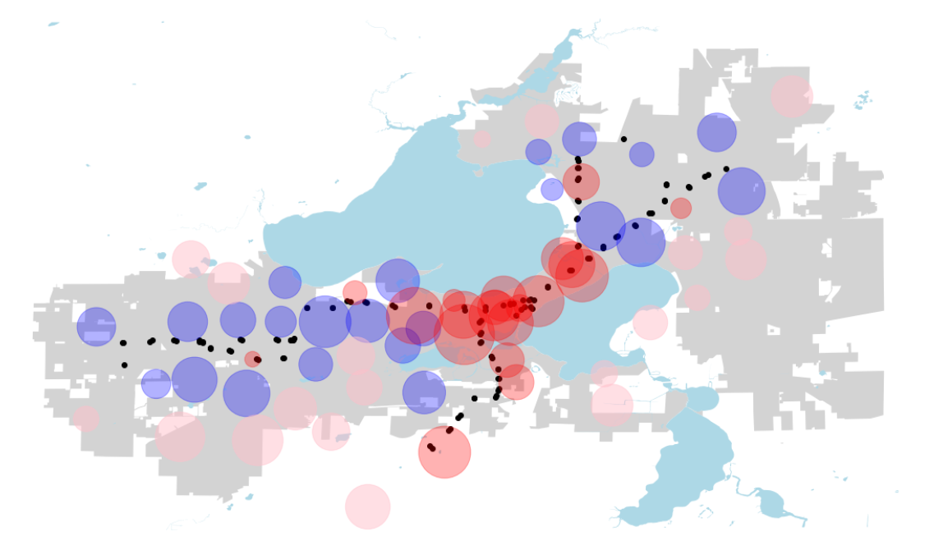
How to go forward…
Future work
Use distance covered instead of stops covered as measurement
Compare how the BRT would change the graph output

